Slide 1
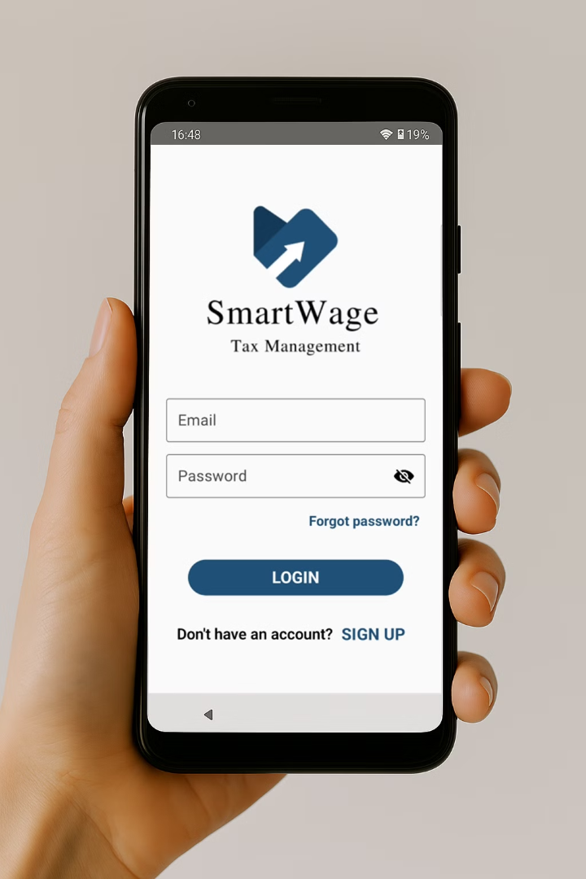
SmartWage
Tax Management
A mobile app to simplify Irish tax calculations!
Dorset College Dublin - Final Project - BSC30924
Developers :
Supervisor :
Filipe Lutz - 25956
WenHao Fu
Vinicius Miranda - 70973

Slide 2





The Problem:
Tax Calculation Complexity
Complicated Tax System
USC, PAYE, and PRSI hard to track, especially with multiple incomes.
Lack of Real-time Clarity
Employees struggle to estimate their real tax liability.
Stress and Confusion
Uncertainty about tax obligations can lead to financial stress.

Slide 3
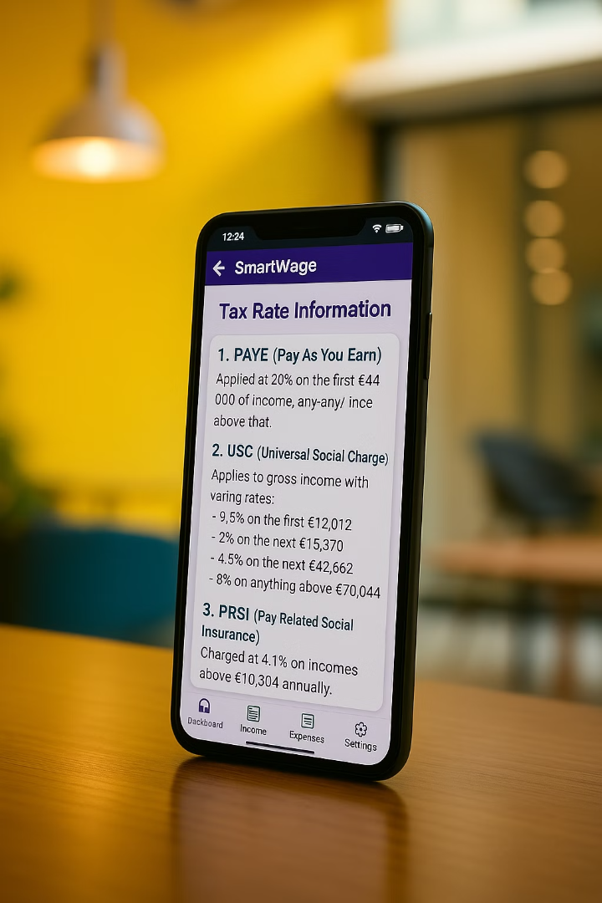
The Solution:
SmartWage Mobile App
Automated Tax Breakdown
Instantly calculates taxes based on Revenue guidelines. (PAYE, USC, PRSI and Tax Credits)
User-friendly Interface
Easily add multiple income and expenses.
Accurate Net Pay Estimates
It helps employees to understand how much tax they under or over paid.

Slide 4



Project Motivation
Tax Complexity:
1
A lot of tax credit/relief goes unclaimed because people don't know how it works.
Market Gap:
2
No existing mobile app for Irish tax calculation.
Social Good:
3
The app help employees to make informed financial decisions and understand tax liability.
"Understand Irish tax was personally difficult, especially managing multiple jobs. We realized there's no mobile app solving this, so we built one"

Slide 5
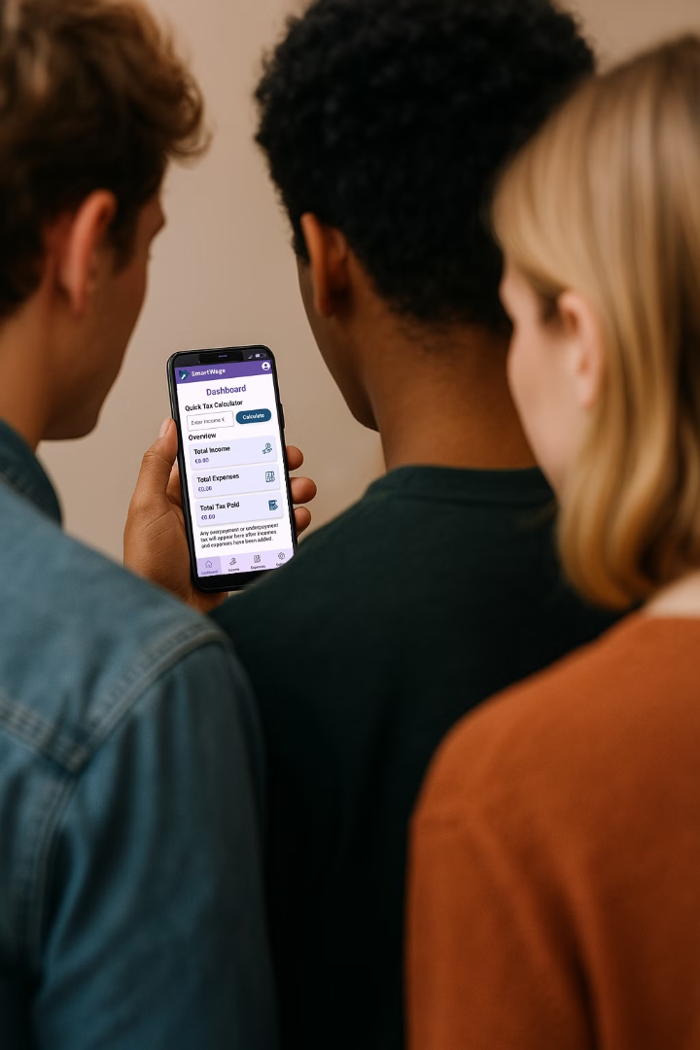


Target Audience
Students
Working Part-time
(Usually have more than one job)
Employees
Seeking financial clarity
Employees in Ireland who need better insight into their tax contribution.

Slide 6
Building SmartWage
Tech Stack
Development
Tax Rules
Frontend: Kotlin + Jetpack Compose
Agile approach
Revenue.ie guidelines
Backend: Firebase + Room DB
UI/UX-driven development
Tax Rate 2025
Authentication: Firebase Auth
Testing

Slide 7
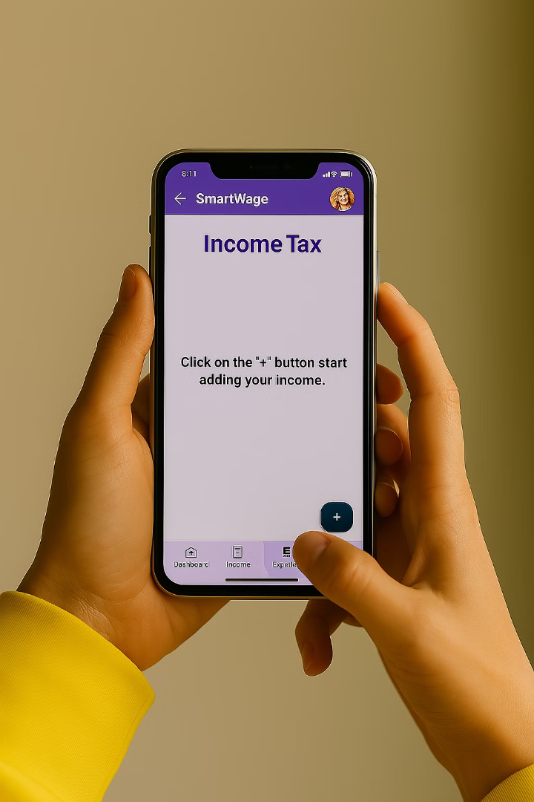




Live Demo
Income Input
Enter payslips with gross pay and taxes paid.
Expense Input
Enter rent or tuition fee paid if applicable.
View Tax Breakdown
See expected taxes and net pay instantly.
Get Insights
Understand over/underpayment.

Slide 8

Project Timeline
Future Implementations
5
Two-Factor
Authentication
1
Research
6
PDF document
exports
2
Design & Prototyping
7
Real-time
alerts
3
MVP Development
8
Payslip
Scanner
4
Testing

Slide 9


